Slide 1
Golden Ticket Campaign
30th July – 31st August 2020

Slide 2
Summary
On 30th July the ERBID launched a new attraction-specific campaign, in the form of a competition. The ‘Golden Ticket Competition’ gave one winner 14 one-time-entry family tickets to English Riviera attractions and activities. The competition closed on 31st August and a winner selected at random in early September.
Aim: to highlight the attractions that have re-opened and create a buzz around the English Riviera this summer whilst promoting the good feeling of ‘giving something back’ to people who have had a difficult few months.
Targeting: locals and day visitors.
Advertising: digital advertising (Google Search, Google Display, Facebook and Instagram) and The Breeze.
Results:
3,727,841 impressions/impacts through digital and radio advertising.
Competition pageviews: 14,750, making it the 5th most viewed webpage for August 2020.
Competition entries: 3,768.

Slide 3
Prize
The prize is a bundle of 14 one-time-entry family tickets to English Riviera attractions and activities, including:
Babbacombe Model Village
Bygones
Dartmouth Steam Railway
Dinosaur World
English Riviera Wheel
Golden Hind
Kents Cavern
Torquay Land Train
Paignton Zoo
Reach Outdoors (2 hour introductory Paddleboard or Kayak session for a family of four)
Real Crime Museum
Splashdown Quaywest
Torquay Museum
Torre Abbey

Slide 4
Campaign Assets

Slide 5
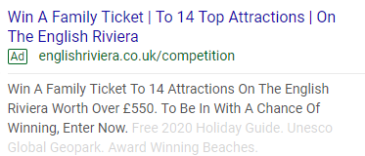
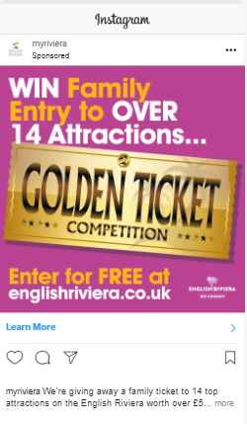
Digital Advertising
A range of digital advertising platforms were used as they each provide different benefits:
Google Search: provides high click through rates.
Google Display: provides high impressions thereby increasing awareness.
Facebook and Instagram: both provide good click through rates, high awareness and allows for engagement.

Slide 6
Digital Advertising Results
Advertising platform | Impressions | Clicks | Click through rate | Spend
Google Search | 12,496 | 1,176 | 9.41% | £794.97
Google Display | 1,246,750 | 9,431 | 0.76% | £682.25
Facebook and Instagram | 392,906 | 4,143 | 1.05% | £750
TOTALS | 1,652,152 | 14,750 | 3.74% average | £2,227.22
In addition to this, the Facebook and Instagram campaign has a high engagement rate of 4.31%.

Slide 7
The Breeze
From 1st – 28th August, there were two promotions on local radio.
This includes a 30 second advert and two versions of a 12 second sponsor message on Matt Rogan’s Breakfast Programme.
The 30 second advert was played 8 times a day between 6am-7pm, for 4 weeks.
The 12 second sponsorship credit was played 12 times a day, from 6am-10am, Monday-Friday for 4 weeks.
The results are below.
 | Impacts | Reach | OTH
Breakfast Sponsorship | 1,373,892 | 44,920 | 30.59
Airtime advert | 701,797 | 45,015 | 15.59
TOTALS | 2,075,689 | 89,935 | n/a

Slide 8
Competition Entries
Competition Entries: 3,768.
Competition Entry Webpage Views: 14,750. It was the 5th most viewed webpage for August 2020.
We asked the entrants two questions to help us understand more about them. The results are below.
Where did you hear about the competition? | Number of entries
English Riviera Facebook | 2079
Other | 1011
Participating attractions social media | 374
The Breeze | 156
English Riviera Instagram | 87
English Riviera Twitter | 61
Have you used the English Riviera website before? | Number of entries
To find out what events are on | 1509
To plan a day out | 1091
Learn more about the English Riviera | 503
Holiday inspiration | 359
To plan a holiday | 306

Slide 9
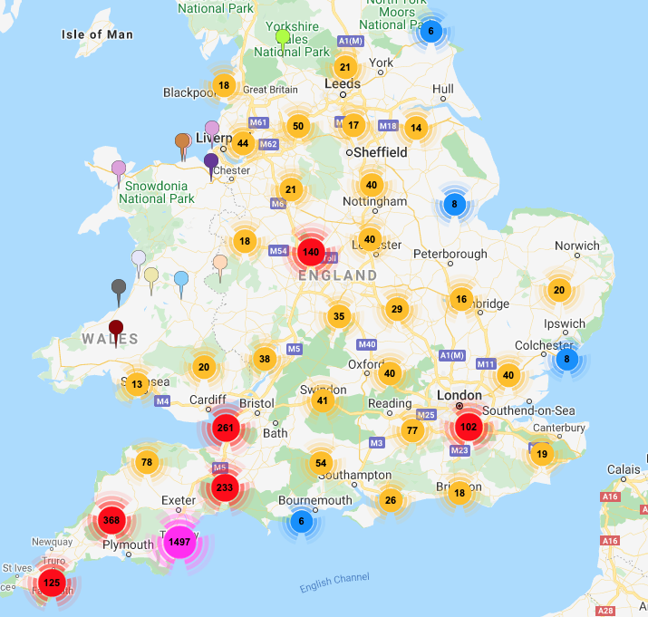
Postcode Analysis
As expected, the majority of the postcodes were local, with almost 1500 entries from Torbay alone.
This is likely to due the targeting from the Digital Advertising and the use of the local radio, The Breeze.
Plymouth postcodes were the next most popular, followed by Bristol, Exeter, Birmingham and then London.

Slide 10
Budget
The total budget for this campaign is £4,500.
The actual spend has been detailed below:
Design of campaign assets: £285
The Breeze (including production): £1,850
Facebook and Instagram advertising: £750
Google Search: £794.97
Google Display: £682.25
TOTAL: £4,362.22

